Slide 1
Defense Mode

Slide 2
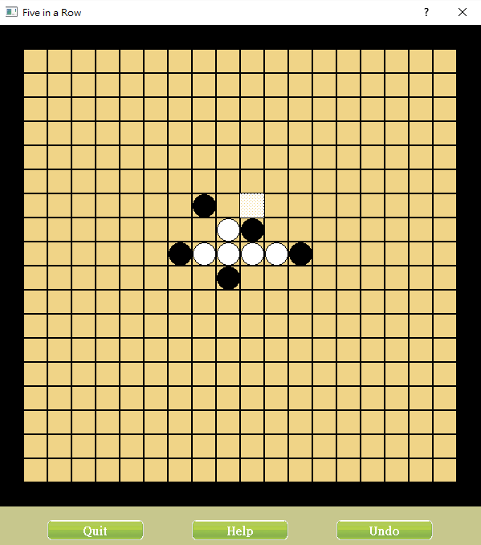

Slide 3
If player (white) place a piece here, it connects 3 in a row

Slide 4
Yet the computer (black) does not have any pieces connected

Slide 5
Yet the computer (black) does not have any pieces connected
DEFENSE MODE

Slide 6
Yet the computer (black) does not have any pieces connected
DEFENSE MODE
Try to block the white connections

Slide 7
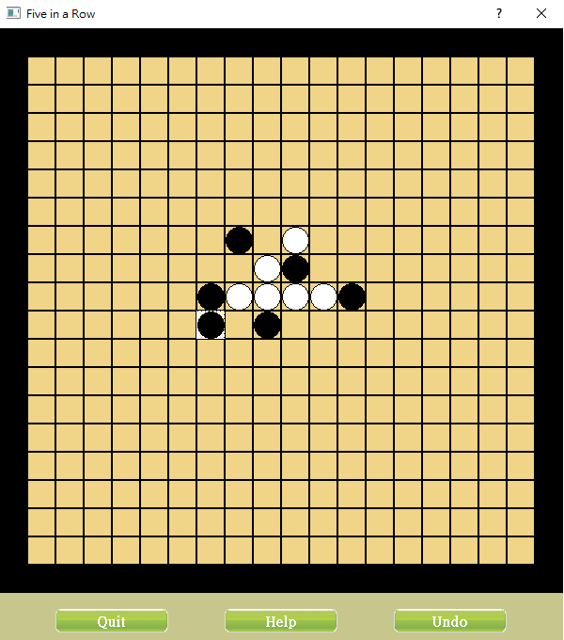
The computer (black) blocks the white connection

Slide 8
Offense Mode

Slide 9
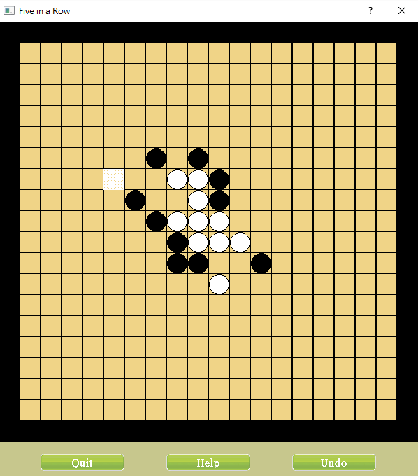

Slide 10
Player (white) must place a piece here to prevent the computer from connecting 5 in a row

Slide 11
The Computer realize that the player is not able to connect 3 or more pieces in a row in this turn

Slide 12
The Computer realize that the player is not able to connect 3 or more pieces in a row in this turn
OFFENSE MODE

Slide 13
The Computer realize that the player is not able to connect 3 or more pieces in a row in this turn
OFFENSE MODE
Try to connect 3 blacks in a row

Slide 14
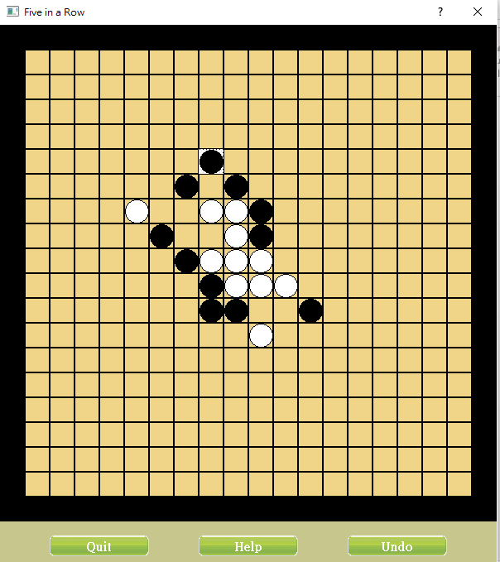
The computer (black) connects 3 in a row

